Slide 1
CSE 31 Computer Organization
Lecture 22 – CPU Design (1)

Slide 2
Announcement
No lab this week
Project #1 grading during lab
HW #6 out at CatCourses (not zyBooks)
Due Friday (11/30, extended) at 11:59pm
Project #2
Due Monday (12/3)
Don’t start late, you won’t have time!
Course evaluation online
Fill out by 12/6 (Thursday)
Reading assignment
Chapter 5.1 – 5.6 of zyBooks (Reading Assignment #6)
Make sure to do the Participation Activities
Due Monday (11/26)

Slide 3
Announcement
Midterm Exam 2
11/28 (Wednesday, in lecture) Not 11/7 as scheduled
Lectures #8 - #18
HW #3 - #5
Practice exam in CatCourses
Closed book
1 sheet of note (8.5” x 11”)
MIPS reference sheet will be provided

Slide 4
Review
C program: foo.c
Compiler
Assembly program: foo.s
Assembler
Object(mach lang module): foo.o
Linker
lib.o
Executable(mach lang pgm): a.out
Loader
Memory

Slide 5
What are “Machine Structures”?
Application (Chrome)
CSE 31
Operating
Compiler
System
(MacOS X)
Software
Assembler
Instruction Set
Architecture
Hardware
Processor
Memory
I/O system
Datapath & Control
Digital Design
Circuit Design
transistors
Coordination of many levels of abstraction
ISA is an important abstraction level: contract between HW & SW

Slide 6
Below the Program
High-level language program (in C)
swap int v[], int k){
int temp;
temp = v[k];
v[k] = v[k+1];
v[k+1] = temp;
}
Assembly language program (for MIPS)
swap: sll $2, $5, 2
add $2, $4,$2
lw $15, 0($2)
lw $16, 4($2)
sw $16, 0($2)
sw $15, 4($2)
jr $31
Machine (object) code (for MIPS)
000000 00000 00101 0001000010000000
000000 00100 00010 0001000000100000 . . .
C compiler
assembler
?
Notes:
For lecture
Computer only understands zeros and ones – instructions of 0’s and 1’s
Early programmers found representing machine instructions in a symbolic notation – assembly language
And developed programs that translate from assembler to machine code
Eventually, programmers found working even in assembler too tedious so migrated to higher-level languages and developed compilers that would translate from the higher-level languages to assembler

Slide 7
Synchronous Digital Systems
The hardware of a processor, such as the MIPS, is an example of a Synchronous Digital System
Synchronous:
Means all operations are coordinated by a central clock.
It keeps the “heartbeat” of the system!
Digital:
Mean all values are represented by discrete values
Electrical signals are treated as 1’s and 0’s and grouped together to form words.

Slide 8
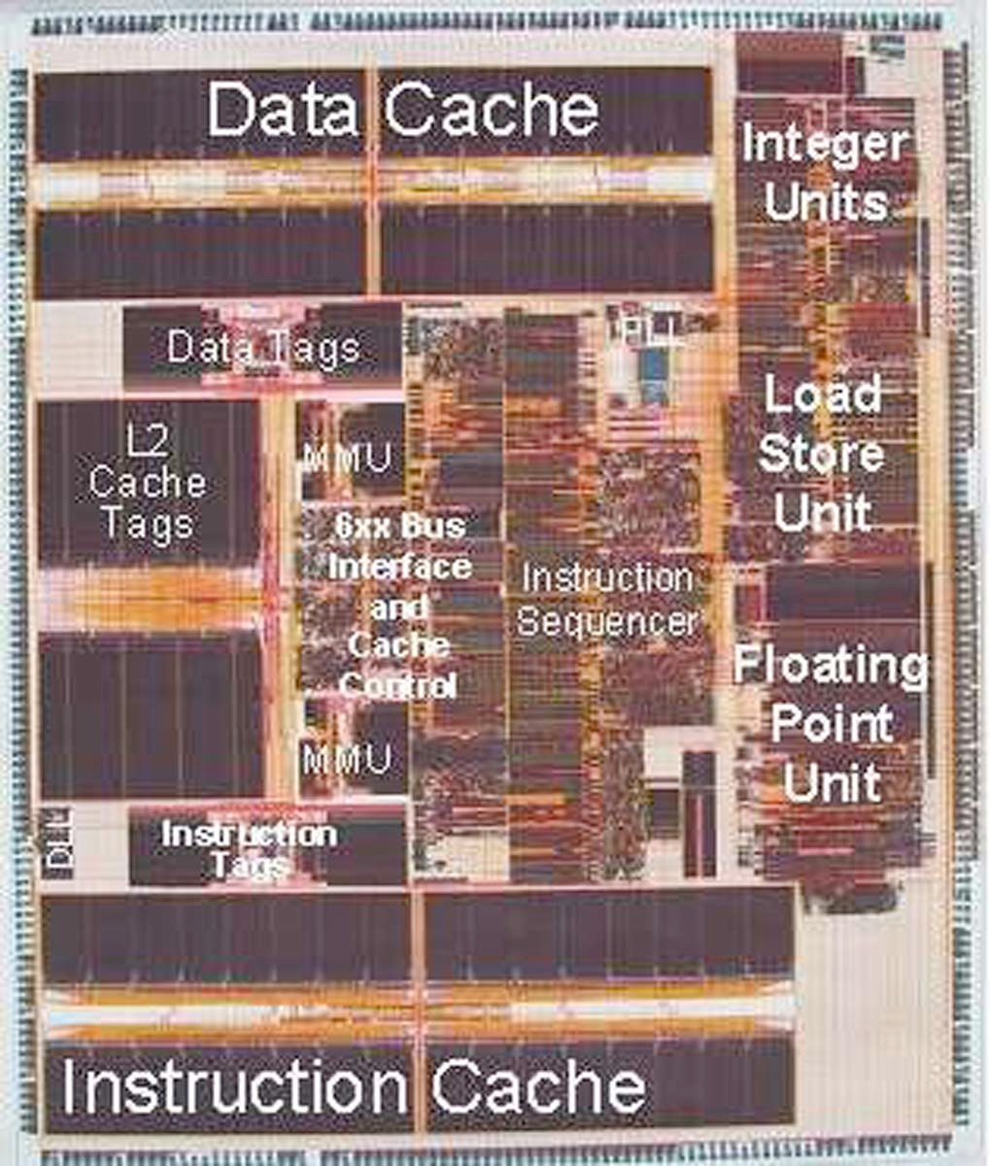

PowerPC Die Photograph
Let’s look closer…

Slide 9
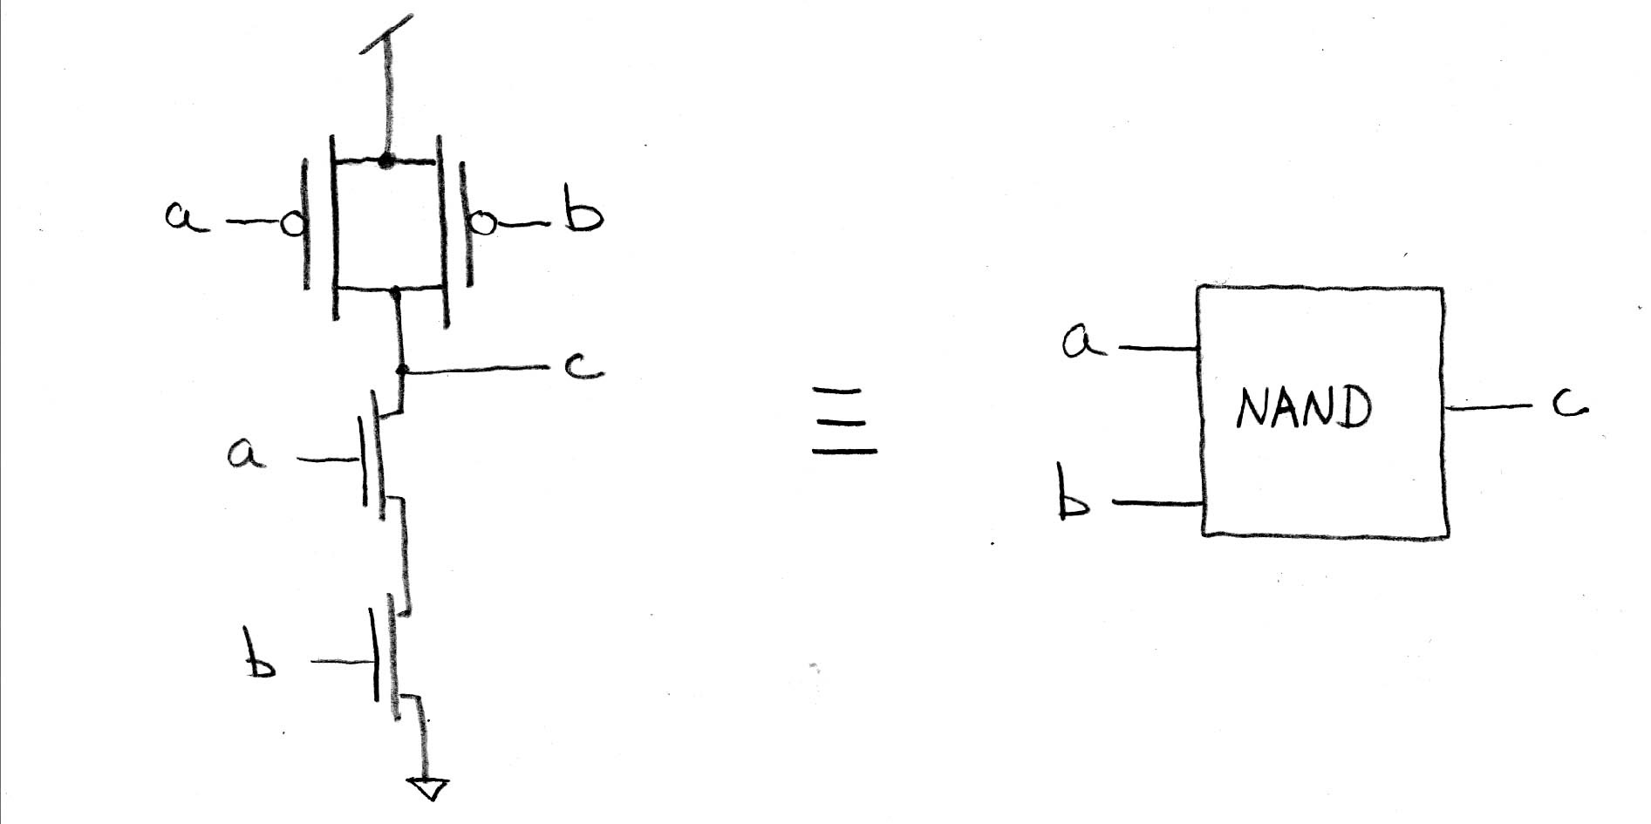
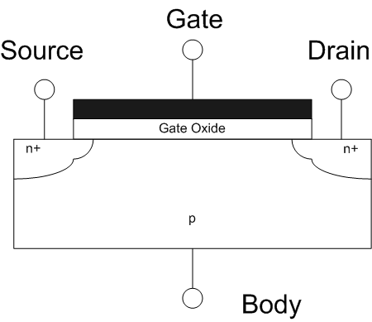
Transistors 101
D
S
MOSFET
Metal-Oxide-Semiconductor Field-Effect Transistor
Come in two types:
n-type NMOSFET
p-type PMOSFET
For n-type (p-type opposite)
If voltage not enough between G & S, transistor turns “off” (cut-off) and Drain-Source NOT connected
If the G & S voltage is high enough, transistor turns “on” (saturation) and Drain-Source ARE connected
G
G
S
D
n-type
p-type
Side view
www.wikipedia.org/wiki/Mosfet

Slide 10
Transistor Circuit Rep. vs. Block diagram
Chips is composed of nothing but transistors and wires.
Small groups of transistors form useful building blocks.
Block are organized in a hierarchy to build higher-level blocks: ex: adders.
“1” (voltage source)
a
b
c
0
0
1
0
1
1
1
0
1
1
1
0
“0” (ground)

Slide 11
Five Components of a Computer
Computer
Keyboard, Mouse
Processor
Devices
Memory
(passive)
(where
programs,
data live
when
running)
Disk (where
programs,
data live when not running)
Input
Control
Output
Datapath
Display, Printer

Slide 12
The CPU
Processor (CPU): the active part of the computer, which does all the work (data manipulation and decision-making)
Datapath: portion of the processor which contains hardware necessary to perform operations required by the processor (the brawn)
Control: portion of the processor (also in hardware) which tells the datapath what needs to be done (the brain)

Slide 13
Stages of the Datapath
Problem: a single, atomic block which “executes an instruction” (performs all necessary operations beginning with fetching the instruction) would be too bulky and inefficient
Solution: break up the process of “executing an instruction” into stages, and then connect the stages to create the whole datapath
smaller stages are easier to design
easy to optimize (change) one stage without touching the others

Slide 14
Stages of the Datapath (1/5)
There is a wide variety of MIPS instructions: so what general steps do they have in common?
Stage 1: Instruction Fetch
no matter what the instruction type is, the 32-bit instruction word must first be fetched from memory (the cache-memory hierarchy)
also, this is where we Increment PC (that is, PC = PC + 4, to point to the next instruction: byte addressing so + 4)

Slide 15
Stages of the Datapath (2/5)
Stage 2: Instruction Decode
upon fetching the instruction, we next gather data from the fields (decode all necessary instruction data)
first, read the opcode to determine instruction type and field lengths
second, read in data from all necessary registers
for add, read two registers (R-format)
for addi, read one register (I-format)
for jal, no reads necessary (J-format)

Slide 16
Stages of the Datapath (3/5)
Stage 3: ALU (Arithmetic-Logic Unit)
the real work of most instructions is done here: arithmetic (+, -, *, /), shifting, logic (&, |), comparisons (slt)
what about loads and stores, do they need this stage?
lw $t0, 40($t1)
the address we are accessing in memory = the value in $t1 PLUS the value 40
so we do this addition in this stage

Slide 17
Stages of the Datapath (4/5)
Stage 4: Memory Access
actually only the load and store instructions do anything during this stage; the others remain idle during this stage or skip it all together
since these instructions have a unique step, we need this extra stage to account for them
as a result of the cache system, this stage is expected to be fast

Slide 18
Stages of the Datapath (5/5)
Stage 5: Register Write
most instructions write the result of some computation into a register
examples: arithmetic, logical, shifts, loads, slt
what about stores, branches, jumps?
don’t write anything into a register at the end
these remain idle during this fifth stage or skip it all together

Slide 19
Generic Diagram of Datapath
rd
PC
instruction
memory
rs
registers
rt
ALU
Data
memory
+4
imm
2. Decode/
Register
Read
1. Instruction
Fetch
5. Register
Write
3. Execute
4. Memory

Slide 20
Datapath Walkthroughs (1/3)
add $r3,$r1,$r2 # r3 = r1+r2
Stage 1: fetch this instruction, inc. PC
Stage 2: decode to find it’s an add, then read registers $r1 and $r2
Stage 3: add the two values retrieved in Stage 2
Stage 4: idle (nothing to write to memory)
Stage 5: write result of Stage 3 into register $r3

Slide 21
Example: add Instruction
reg[1]+ reg[2]
reg[1]
3
PC
instruction
memory
1
registers
2
reg[2]
ALU
Data
memory
imm
+4
add r3, r1, r2

Slide 22
Datapath Walkthroughs (2/3)
slti $r3,$r1,17
Stage 1: fetch this instruction, inc. PC
Stage 2: decode to find it’s an slti, then read register $r1
Stage 3: compare value retrieved in Stage 2 with the integer 17
Stage 4: idle
Stage 5: write the result of Stage 3 in register $r3

Slide 23
Example: slti Instruction
reg[1] <17?
reg[1]
x
PC
instruction
memory
1
registers
3
ALU
Data
memory
imm
17
+4
slti r3, r1, 17

Slide 24
Datapath Walkthroughs (3/3)
sw $r3, 17($r1)
Stage 1: fetch this instruction, inc. PC
Stage 2: decode to find it’s a sw, then read registers $r1 and $r3
Stage 3: add 17 to value in register $r1 (retrieved in Stage 2)
Stage 4: write value in register $r3 (retrieved in Stage 2) into memory address computed in Stage 3
Stage 5: idle (nothing to write into a register)

Slide 25
Example: sw Instruction
reg[1] +17
reg[1]
x
PC
instruction
memory
1
registers
reg[3]
ALU
Data
memory
3
imm
17
+4
SW r3, 17(r1)
MEM[r1+17]<=r3

Slide 26
Why Five Stages? (1/2)
Could we have a different number of stages?
Yes, and other architectures do
So why does MIPS have five if instructions tend to idle for at least one stage?
The five stages are the union of all the operations needed by all the instructions.
There is one instruction that uses all five stages: the load

Slide 27
Why Five Stages? (2/2)
lw $r3, 17($r1)
Stage 1: fetch this instruction, inc. PC
Stage 2: decode to find it’s a lw, then read register $r1
Stage 3: add 17 to value in register $r1 (retrieved in Stage 2)
Stage 4: read value from memory address compute in Stage 3
Stage 5: write value found in Stage 4 into register $r3

Slide 28
Example: lw Instruction
reg[1]
reg[1] +17
x
PC
instruction
memory
1
registers
3
ALU
Data
memory
imm
MEM[r1+17]
+4
17
LW r3, 17(r1)

Slide 29
Datapath Summary
Datapath based on data transfers required to perform instructions
Controller causes the right transfers to happen
rd
PC
instruction
memory
rs
registers
rt
ALU
Data
memory
+4
imm
opcode, funct
Controller

Slide 30
CPU clocking (1/2)
For each instruction, how do we control the flow of information though the datapath?
Single Cycle CPU: All stages of an instruction completed within one long clock cycle
Clock cycle sufficiently long to allow each instruction to complete all stages without interruption within one cycle
2. Decode/
Register
Read
1. Instruction
Fetch
5. Reg.
Write
3. Execute
4. Memory

Slide 31
CPU clocking (2/2)
Multiple-cycle CPU: only one stage of instruction per clock cycle
Clock is made as long as the slowest stage
Several significant advantages over single cycle execution: Unused stages in a particular instruction can be skipped OR instructions can be pipelined (overlapped)
Will talk about this in CSE 140!
2. Decode/
Register
Read
1. Instruction
Fetch
3. Execute
4. Memory
5. Register
Write

Slide 32
What Hardware Is Needed? (1/2)
PC: a register which keeps track of memory addr of the next instruction
General Purpose Registers
used in Stages 2 (Read) and 5 (Write)
MIPS has 32 of these
Memory
used in Stages 1 (Fetch) and 4 (R/W)
cache system makes these two stages as fast as the others, on average

Slide 33
What Hardware Is Needed? (2/2)
ALU
used in Stage 3
something that performs all necessary functions: arithmetic, logicals, etc.
we’ll design details later
Miscellaneous Registers
In implementations with only one stage per clock cycle, registers are inserted between stages to hold intermediate data and control signals as they travels from stage to stage.
Note: Register is a general purpose term meaning something that stores bits. Not all registers are in the “register file”.

Slide 34
Quiz
If the destination reg is the same as the source reg, we could compute the incorrect value!
We’re going to be able to read 2 registers and write a 3rd in 1 cycle
Datapath is hard, Control is easy

Slide 35
Summary
CPU design involves Datapath,Control
Datapath in MIPS involves 5 CPU stages
Instruction Fetch
Instruction Decode & Register Read
ALU (Execute)
Memory
Register Write

